Slide 1
CSE428: Image Processing
Lecture 5

Slide 2
Neighbourhood processing: Part 1

Slide 3
Contents
Spatial operations
Neighborhood operations
Spatial filtering
Image padding
Linear spatial filtering
Correlation and convolution
Smoothing spatial filters: Gaussian, Average & Median filtering
Unsharp masking & high boost filtering
Geometric transformations

Slide 4
Spatial Operations
Can be subdivided into 3 broad categories:
Single-pixel operations or point processing (covered in the last lecture)
Neighborhood operations or neighborhood processing
Geometric spatial transformations (won’t go into too much detail)

Slide 5
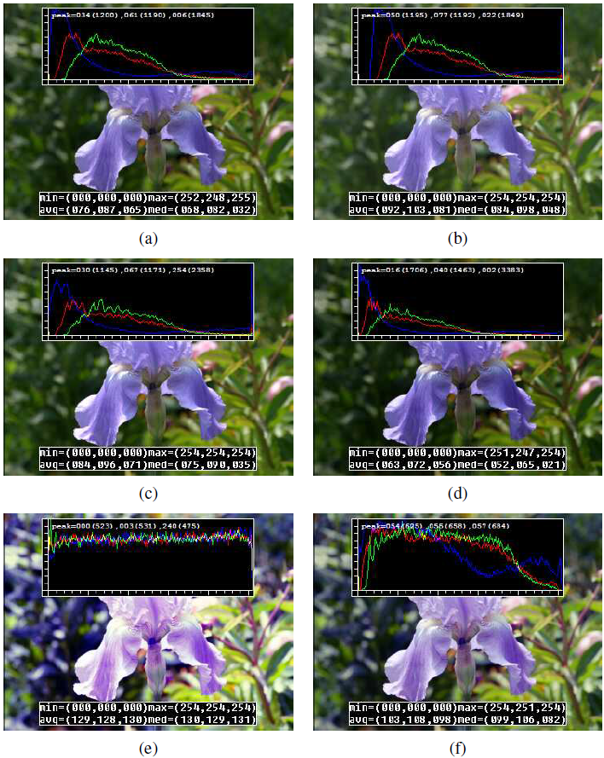
Single-pixel operations
Simplest possible operation on a digital image: alter the pixel intensities
If T is a transfer function, s = T(z) or
z -> original image pixel intensity s -> mapped intensity
Some local image processing operations:
(a) original image along with its three color histograms;
(b) brightness increased (additive offset, b = 16);
(c) contrast increased (multiplicative gain, a = 1:1);
(d) gamma (partially) linearized ( 𝛾 = 1:2);
(e) full histogram equalization;
(f) partial histogram equalization
Computer Vision: Algorithms and Applications, 2nd Edition, Richard Szeliski

Slide 6
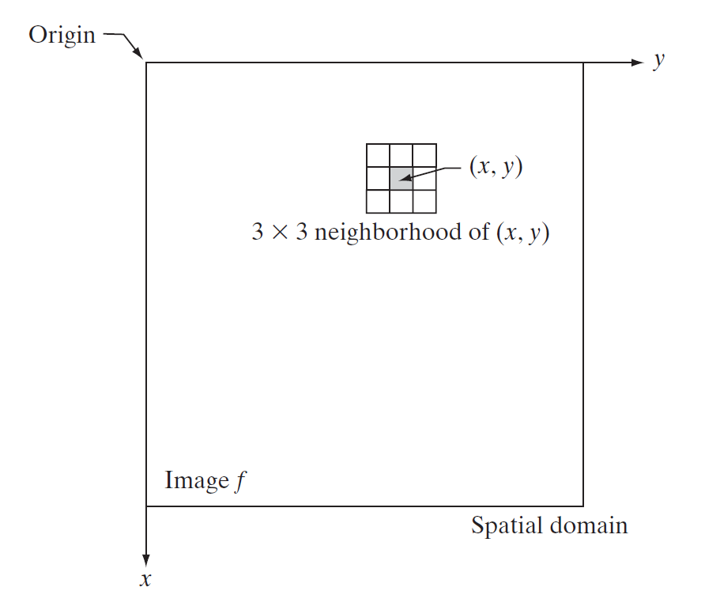
Neighborhood
A pixel p at coordinates has four horizontal and vertical neighbors whose coordinates are given by
(x + 1, y), (x - 1, y), (x, y + 1), (x, y - 1)
This set of pixels, called the 4-neighbors of p, N₄(p)
The four diagonal neighbors of p
(x + 1, y + 1), (x + 1, y - 1), (x - 1, y + 1), (x - 1, y - 1)
Diagonal neighbors of p, N_{D}(p)
4-neighbors together with the diagonal neighbors are called the 8-neighbors of p: N₈(p)
Digital Image Processing, Third Edition, Rafael C. Gonzalez & Richard E. Woods

Slide 7
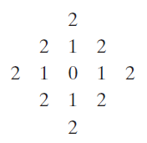
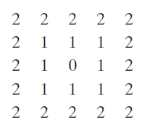
Distance measures
For pixels p, q, and z, with coordinates (x, y), (s, t), and (v, w)
Euclidean distance between p and q
D_{e}(p, q) = [(x - s)² + (y - t)²]^{½}
D₄ distance (city-block distance) between p and q
D₄(p, q) = |x - s| + |y - t|
The pixels with D₄ = 1 are the 4-neighbors of (x, y)
D₈ distance (chessboard distance) between p and q
D₈(p, q) = max(|x - s|, |y - t|)
The pixels with D₈ = 1 are the 8-neighbors of (x, y)
Digital Image Processing, Third Edition, Rafael C. Gonzalez & Richard E. Woods

Slide 8
Linear vs Nonlinear Operations
Consider a general operator, H such that : H [f(x, y)] = g(x, y)
H is said to be a linear operator if the following is true:
H [a₁f₁(x, y) + a₂f₂(x, y)] = a₁H [f₁(x, y)] + a₂H [f₂(x, y)]
Additivity property: output of a linear operation due to the sum of two inputs is the same as performing the operation on the inputs individually and then summing the results
Homogeneity property: the output of a linear operation to a constant times an input is the same as the output of the operation due to the original input multiplied by that constant

Slide 9
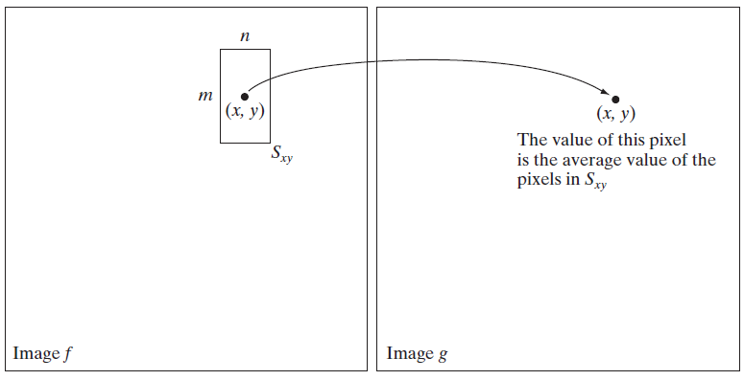
Neighborhood operations
S_{xy} is the set of coordinates of a neighborhood centered on an arbitrary point (x, y) in an image f
Neighborhood processing generates a corresponding pixel at the same coordinates in an output (processed) image, g, such that the value of that pixel is determined by a specified operation involving the pixels in the input image with coordinates in S_{xy}
Digital Image Processing, Third Edition, Rafael C. Gonzalez & Richard E. Woods

Slide 10
Neighborhood operations: Mechanism
Spatial filtering consists of
A neighborhood (defined by the filter kernel, or mask)
A predefined operation (which is performed on the neighborhood)
Linear operation
Nonlinear operation
Filtering creates a new pixel at the same position of the center of the neighborhood, and whose value is the result of the filtering operation
A processed (filtered) image is generated as the center of the filter visits each pixel in the input image

Slide 11
Kernels (Also known as Filters/Masks)
In image processing, a kernel (also known as a filter or convolution mask/matrix) is a small matrix used to apply effects like blurring, sharpening, edge detection, and more to an image.
The kernel is applied to the image through a process called convolution, where the kernel is systematically moved across the image, performing calculations to produce a modified image.
The process of filtering is also known as convolving a mask with an image. As this process is same of convolution so filter masks are also known as convolution masks.

Slide 12
Kernels (Also known as Filters/Masks)
The general process of filtering and applying masks consists of moving the filter/mask from point to point in an image. At each point (x,y) of the original image, the response of a filter is calculated by a pre defined relationship. All the filters values are pre defined.
Here are some common types of filters:
1. Smoothing Filters (Low-pass filters)
2. Sharpening Filters (High-pass filters)
3. Edge Detection Filters
4. Non-Linear Filters

Slide 13
Key Concepts of Kernels
Kernels are typically small matrices, such as 3x3, 5x5, or 7x7. The size of the kernel determines the area of the image that each calculation affects.
The values within the kernel matrix determine the specific effect the kernel will have on the image. These values can be positive or negative and are used in weighted sums with the pixel values of the image.
The kernel is placed on top of the image, covering a portion of it. Each element of the kernel is multiplied by the corresponding image pixel value. The results are summed to get the value of the new pixel in the output image. The kernel is then moved to the next position (typically one pixel to the right or down) and the process is repeated. This whole process is known as Convolution.

Slide 14

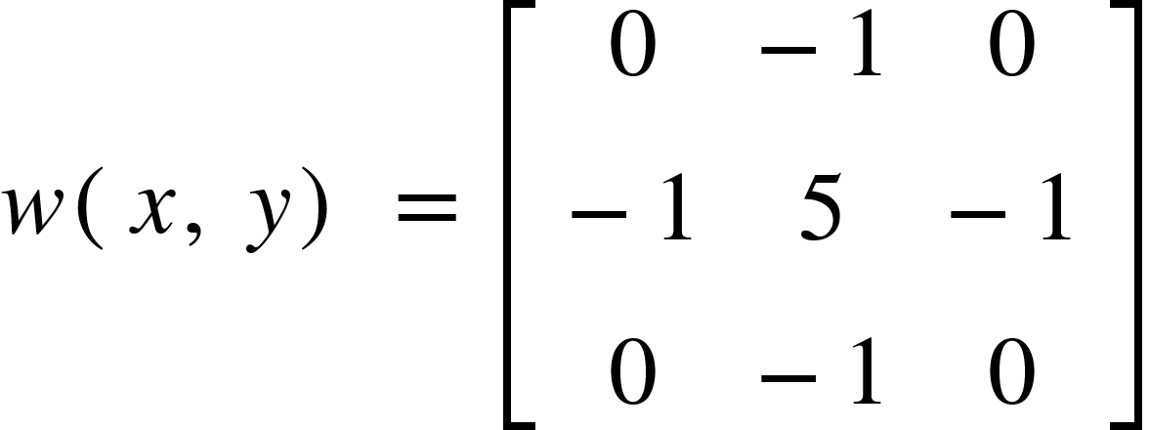
Key Concepts of Kernels
The animation here demonstrates
the process of filtering. Here, edge
Padding was applied to preserve the
dimensions of the input image.
Kernel,

Slide 15
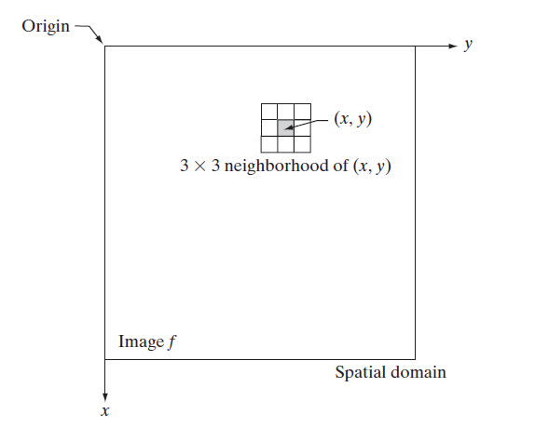
Spatial Filtering
Neighborhood processing is also called spatial filtering
g(x, y) = T [f(x, y)]
Input image: f(x, y)
Output image: g(x, y)
T [ . ] is an operator in f, defined over a neighborhood
Linear operation -> linear spatial filtering
Nonlinear operation -> nonlinear spatial filtering
T can be applied to a single image or multiple images
Example: a 3x3 neighborhood of (x, y)
Digital Image Processing, Third Edition, Rafael C. Gonzalez & Richard E. Woods

Slide 16
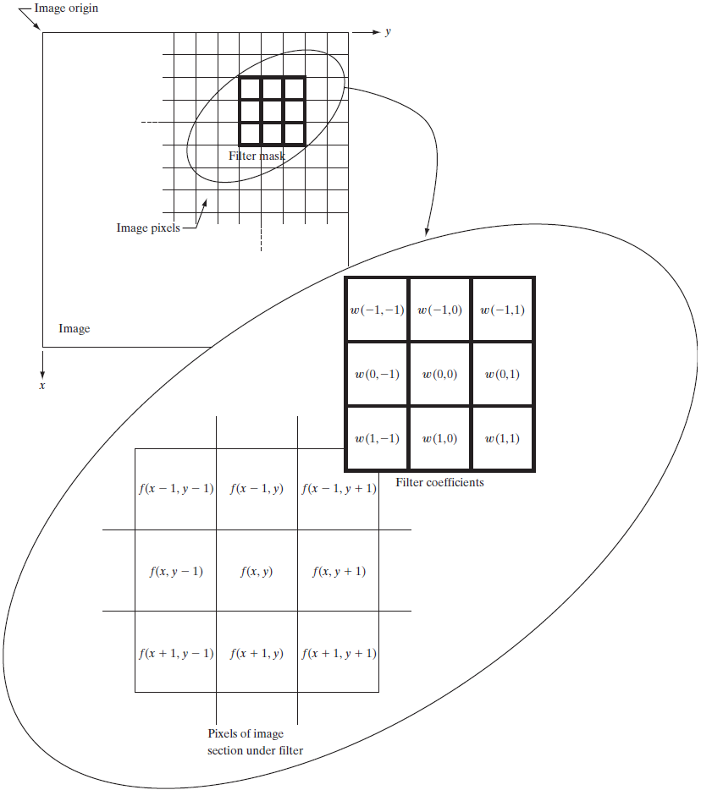
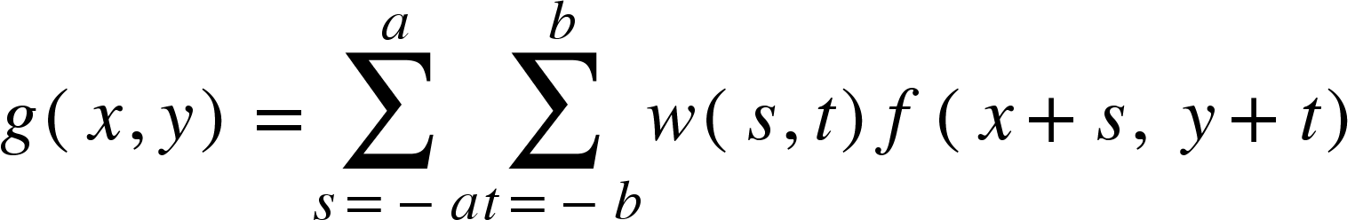
Linear Spatial Filtering
Linear spatial filtering in a m x n neighborhood
Mask/filter/kernel size: m x n
Assume m = 2a + 1, n = 2b + 1 (both odd numbers)
Image size: M x N
Example: g(x, y) = w(-1, -1) f(x-1, y-1) + w(-1, 0) f(x -1, y) + … + w(0, 0) f(x, y) + ... + w(1, 1) f(x+1, y+1)
Digital Image Processing, Third Edition, Rafael C. Gonzalez & Richard E. Woods

Slide 17
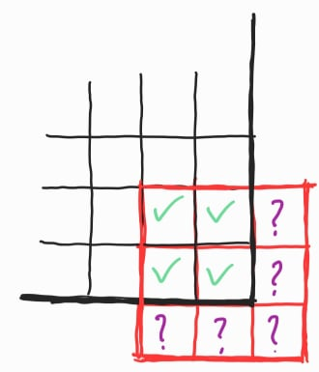
But.. what about the border pixels?

Slide 18
Solution 1: Don’t visit the border pixels!
Result: Image is shrinked

Slide 19
Solution 2: *Padding*
Result: Image shape stays the same

Slide 20
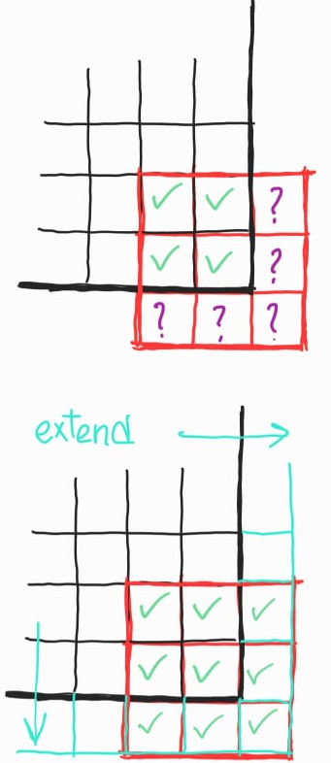
Image Padding
Zero padding: extend the borders of the original image with zeros
Constant padding: extend the borders of the original image with a constant pixel value
Mirror padding: extend the borders of the original image by reflecting the edge pixels
Clamp/Edge/Nearest padding: extend the borders of the original image by repeating edge pixels
More ways: https://scikit-image.org/docs/dev/api/skimage.util.html#skimage.util.pad

Slide 21
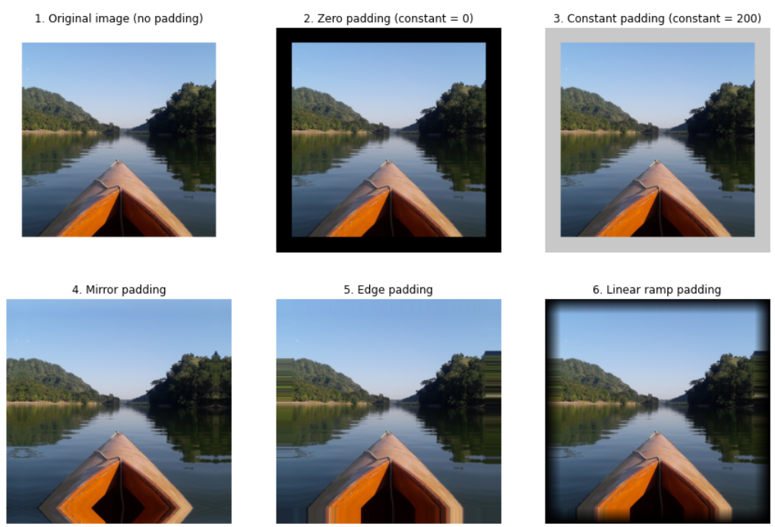
Image Padding
A 1448x1448x3 image padded with 200 pixels on each side:
Original image
Zero padding
Constant padding
Mirror padding
Edge padding
Linear(ramp) padding

Slide 22
Linear Spatial Filtering: Demo
Kernel shape: 3x3
Input image shape: 6x6
Output image shape: 6x6
Padding: Nearest
Step (stride): 1
Kernel,
https://commons.wikimedia.org/wiki/File:2D_Convolution_Animation.gif

Slide 23
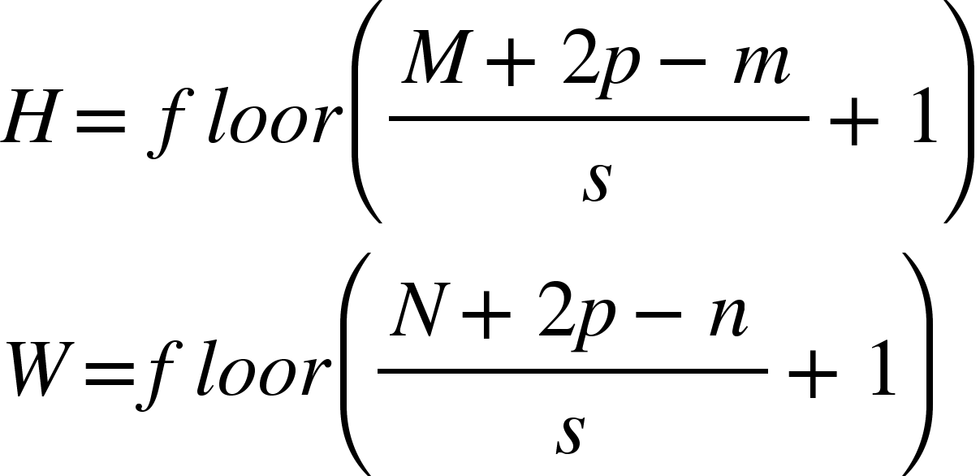
Linear Spatial Filtering: Output Shape
Kernel shape: m x n
Input image shape: M x N
Number of pixels padded: p
Stride: s
Output image shape: H x W
https://commons.wikimedia.org/wiki/File:2D_Convolution_Animation.gif

Slide 24
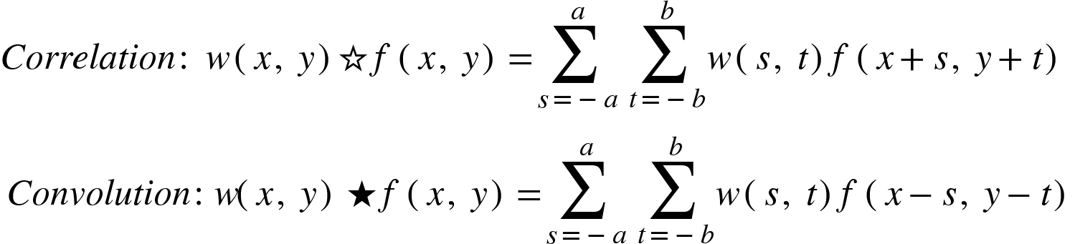
Correlation
Correlation between two 2D signals w(x, y) & f(x, y) is defined as:
Outputs a measure of similarity of the two signals as a function of the displacement of one relative to the other
Also called the cross-correlation
Basically a sliding dot product (vector element wise multiplication)
Used for searching a long signal [f(x, y)] for a shorter signal [w(x, y)] (a known feature)

Slide 25
Linear spatial filtering ⇔ 2D signal correlation

Slide 26
Correlation to Convolution
Linear spatial filtering is basically a 2D signal correlation operation
If we rotate the original filter w(x, y) 180⁰ and then proceed, it’s called the convolution operation
Mathematically,

Slide 27
For symmetric filters,
convolution and correlation both yield the same result!

Slide 28
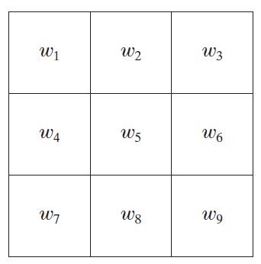
Smoothing Spatial Filters
Linear
Box/average filtering
Gaussian filtering
Non-linear
Median filtering
Example: A 3 x 3 filter with coefficients w₁ through w₉
Digital Image Processing, Third Edition, Rafael C. Gonzalez & Richard E. Woods

Slide 29
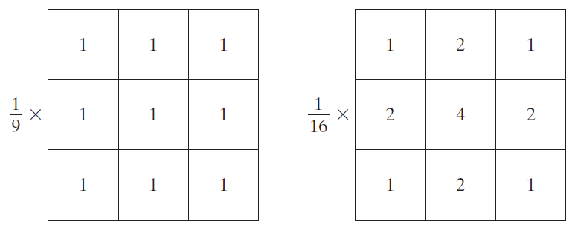
Linear Smoothing Filters
Averaging filter
Average of all the pixels encompassed by the filter kernel
An m x n averaging box kernel: w(x, y) = 1 / m*n
Gaussian filter
Weighted average of all the pixels encompassed by the gaussian filter kernel
An m x n gaussian kernel: w(x, y) = exp(-(x²+y²)/2σ²)
Example: a 3x3 Box filter and a 3x3 Gaussian filter
(note that the filters are normalized so that the intensity of the output pixel remains unchanged)
Digital Image Processing, Third Edition, Rafael C. Gonzalez & Richard E. Woods

Slide 30
Linear Smoothing Filters
Applications
Image Blurring (As the name suggests)
Image Sharpening (wait, sharpening from blurring? what?)
Image Denoising
Low pass filtering (getting rid of high variations)

Slide 31
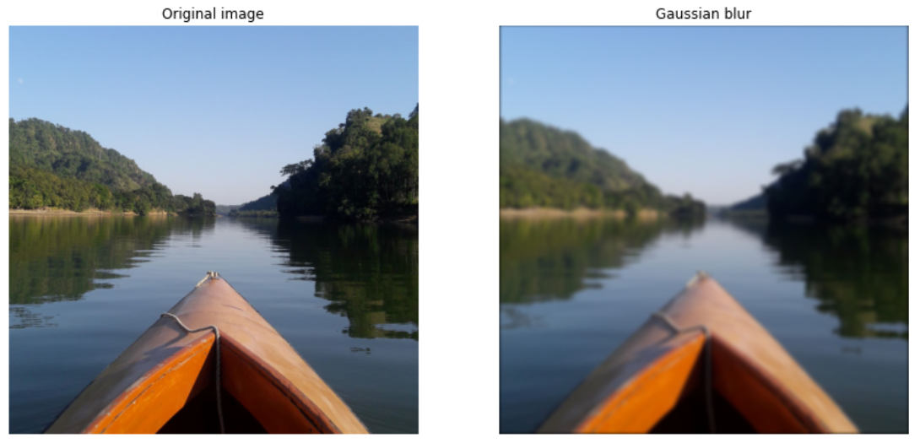
Gaussian Filtering:The Gaussian Blur
Result of filtering an image with with (25 x 25), σ² = 8 Gaussian kernel

Slide 32
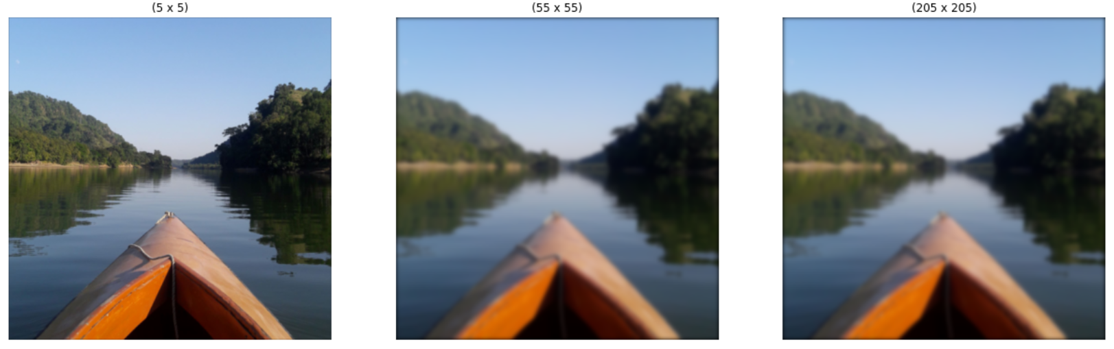
Gaussian Filtering:The Gaussian Blur
Increasing the kernel shape increases blurriness, borders become more prominent

Slide 33
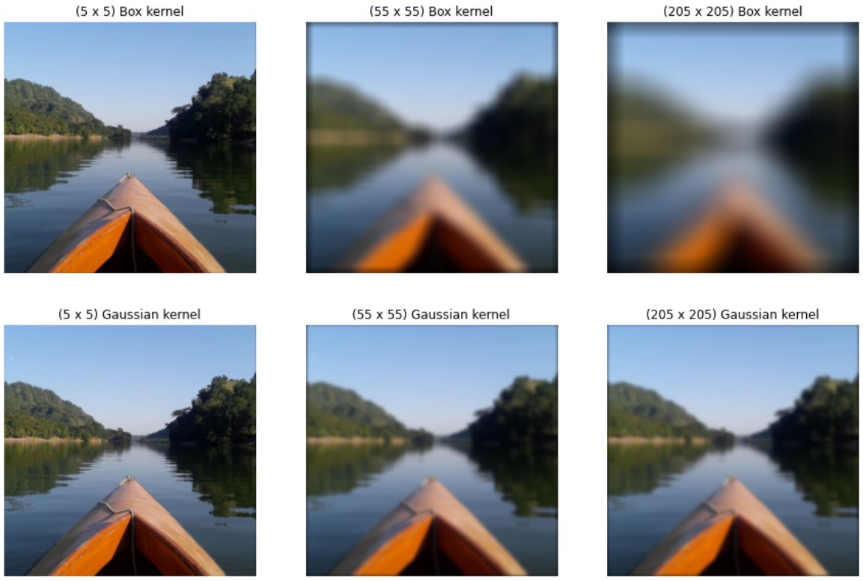
Gaussian Filtering vs Average Filtering
For the same kernel size the gaussian blur preserves more detail of the image
Even though the image is blurred the edges are somewhat better preserved for the gaussian blurring (edge preserving blurring)

Slide 34
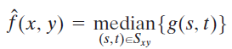
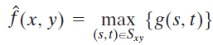
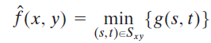
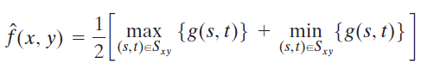
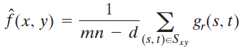
Order Statistic Filtering
Response is based on ordering (ranking) the pixels contained in the pixel neighborhood (S_{xy})
Median filtering:
Max and min filtering:
Midpoint filtering:
Alpha-trimmed mean filtering:

Slide 35
Median Filtering
Median Filter (Order-statistic filter)
nonlinear spatial filter
each pixel value is replaced by the median of the intensity values in the neighborhood
excellent noise-reduction capabilities
less blurring than linear filters
particularly effective with impulse noise (salt and pepper noise)

Slide 36


Noise-corrupted Image
< Original image (left)
Noisy image > (right) (Gaussian noise)

Slide 37

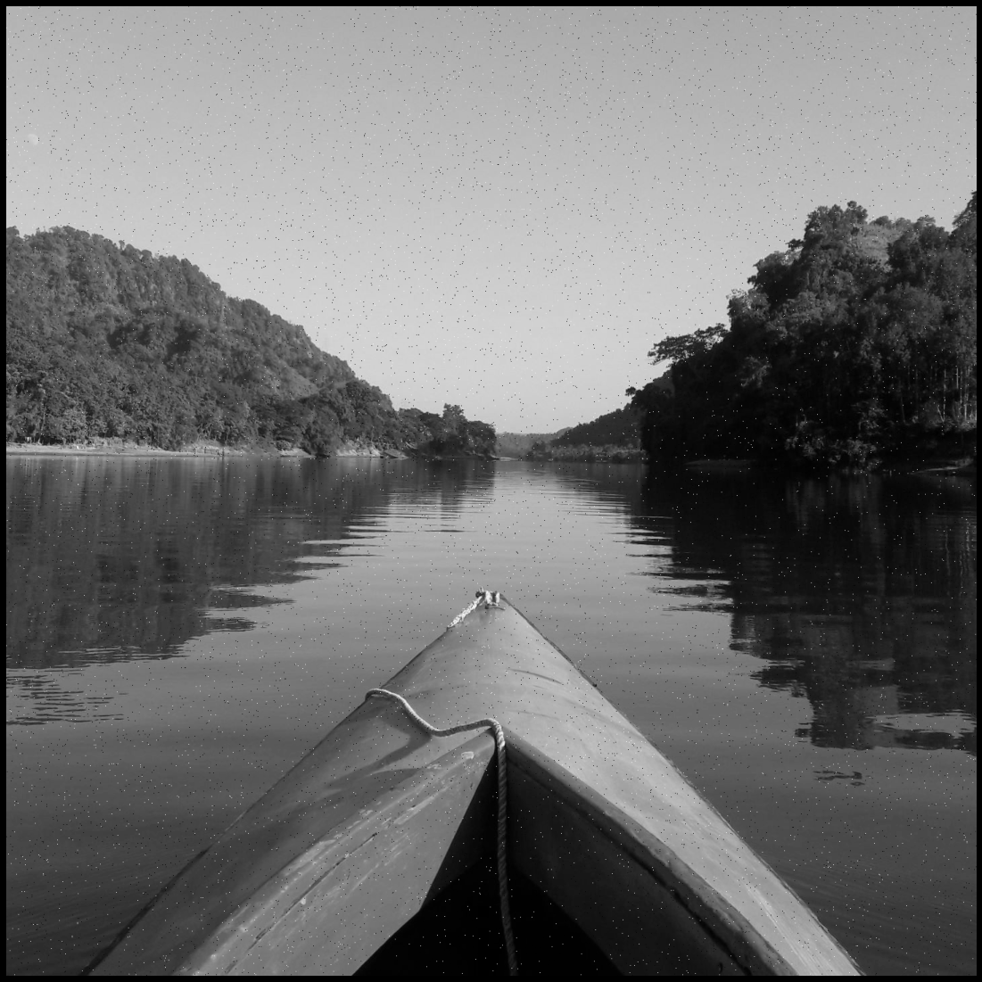
Noise Reduction Using Linear Filtering
< Original grayscale image (left)
Noisy image > (right) (Salt and pepper noise, pretty common for old b&w cameras)

Slide 38

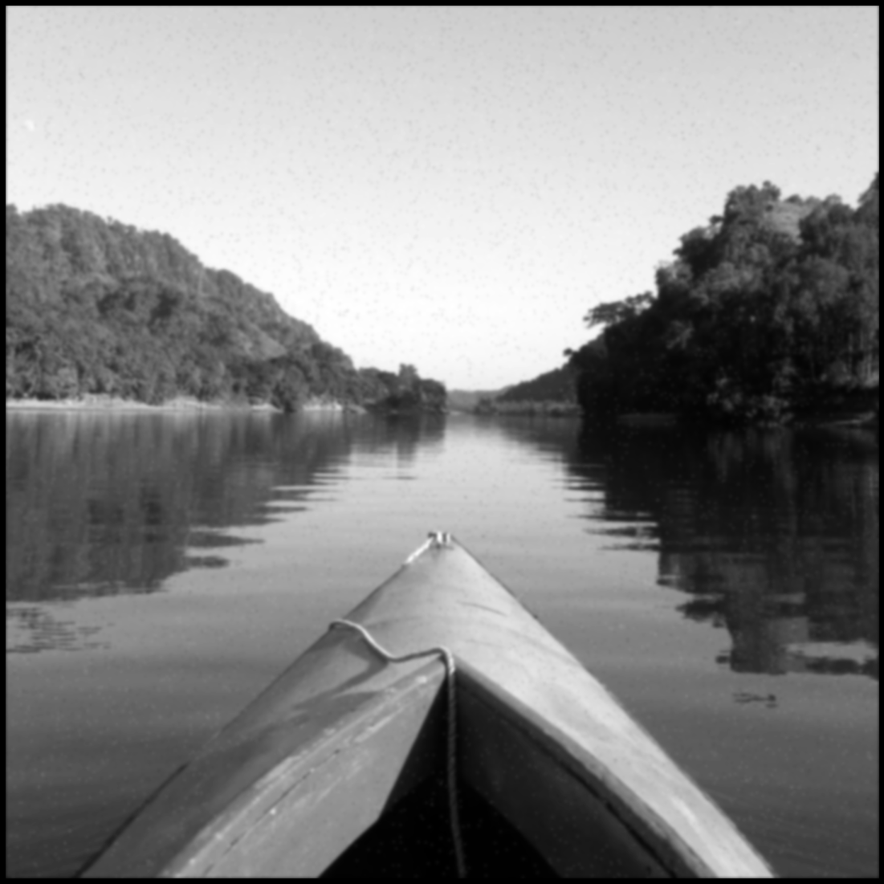
Noise Reduction Using Linear Filtering
Gaussian filter used to denoise both noisy images (25 x 25) σ²=3
Output is blurred, s&p not properly removed

Slide 39

Noise Reduction Using Nonlinear Filtering
Median filter is used to denoise the salt and pepper noise
(can you tell the original from the filtered one?)

Slide 40
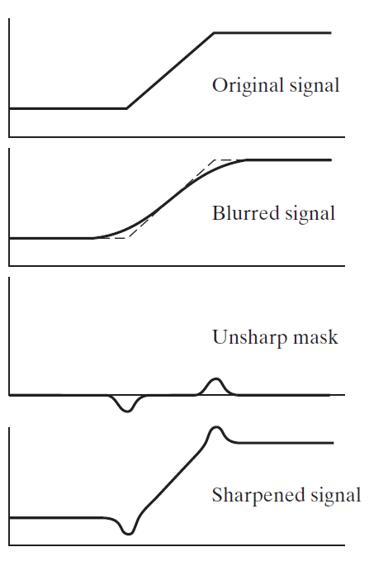
Unsharp Masking & High Boost Filtering
This unsharp masking process consists of the following steps:
Blur the original image
f’(x, y) = Blur[f(x, y)]
Subtract the blurred image from the original (the resulting difference is called the mask)
g_{mask}(x, y) = f(x, y) - f’(x, y)
Add the mask to the original
g(x, y) = f(x, y) + k * g_{mask}(x, y)
k = 1 is unsharp masking, k > 1 is high boost filtering
Digital Image Processing, Third Edition, Rafael C. Gonzalez & Richard E. Woods

Slide 41
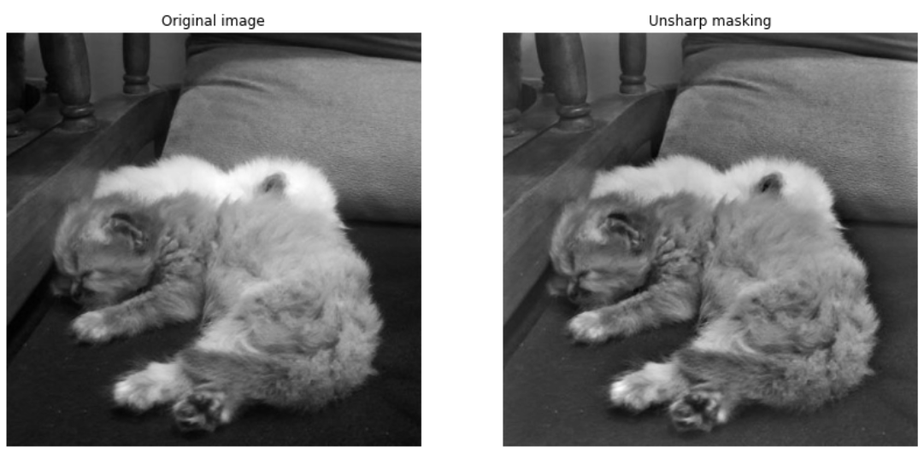
Unsharp Masking

Slide 42
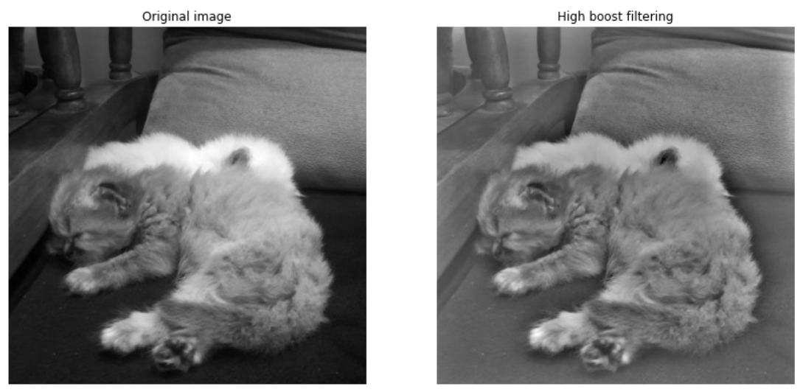
High Boost Filtering

Slide 43
Edge Detection
Sudden changes of discontinuities in an image are known as edges. Significant transitions in an image are called as edges.
Most of the shape information of an image is enclosed in edges.
Often we detect these edges in an image by using filters and then by enhancing those areas of image which contain edges, we increase the sharpness of the image and the image becomes clearer.
Some of the masks used for edge detection are: Prewitt Operator, Sobel Operator, Robinson Compass Masks, Krisch Compass Masks, Laplacian Operator.

Slide 44
Derivative Masks
Edges are calculated by using difference between corresponding pixel intensities of an image. All the masks that are used for edge detection are also known as derivative masks.
An image is a signal so changes in a signal can only be calculated using differentiation. That’s why these operators are also called derivative operators or derivative masks.
All the derivative masks should have the following properties:
Opposite sign should be present in the mask.
Sum of mask should be equal to zero.
More weight means more edge detection.

Slide 45
Prewitt Operator
Prewitt operator provides us with two separate masks. One for detecting edges in horizontal direction and another for detecting edges in an vertical direction.
Mask for detecting edges in Vertical direction:
-1 0 1
-1 0 1
-1 0 1
Mask for detecting edges in Horizontal direction:
-1 -1 -1
0 0 0
1 1 1

Slide 46
Prewitt Operator
When we apply the vertical one it prominents the vertical edges. It simply works like as first order derivative and calculates the difference of pixel intensities in a edge region. As the center column is of zero, it does not include the original values of a pixel but rather it calculates the difference of right and left pixel values around that edge. This increases the edge intensity and it become enhanced comparatively to the original image.
Similar thing happens for the horizontal one too. As the center row of the mask consists of zeros so it does not include the original pixel values of edges in the image, rather it calculates the difference of above and below pixel intensities of the particular edge. Thus increasing the sudden change of intensities and making the edge more visible. Both the above masks follow the principle of derivative mask. Both masks have opposite sign in them and both masks sum equals to zero.

Slide 47
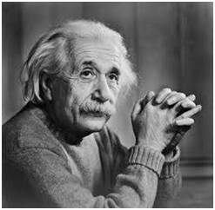
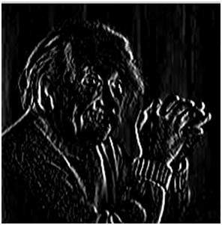
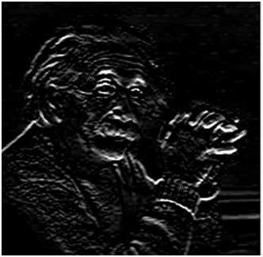
Prewitt Operator
Original Image
After applying Vertical Mask
After applying Horizontal Mask

Slide 48
Sobel Operator
Sobel operator also provides us with two separate masks. One for detecting edges in horizontal direction and another for detecting edges in an vertical direction.
The Sobel operator usually incorporates a weighting of 2 in the middle row/column of the kernels. This weighted approach gives more emphasis to the central pixels, making the Sobel operator more sensitive to edges and less sensitive to noise compared to the Prewitt operator.
Mask for detecting edges in Vertical direction:
-1 0 1
-2 0 2
-1 0 1
Mask for detecting edges in Horizontal direction:
-1 -2 -1
0 0 0
1 2 1

Slide 49
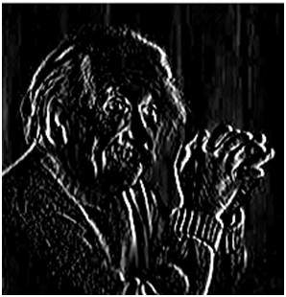
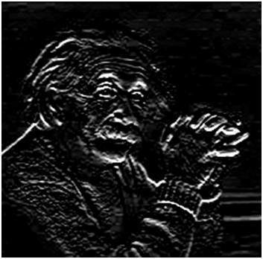
Sobel Operator
Original Image
After applying Vertical Mask
After applying Horizontal Mask

Slide 50
Robinson Compass Masks
Robinson compass mask is another type of derivative mask which is used for edge detection. This operator is also known as direction mask. In this operator we take one mask and rotate it in all the 8 compass major directions that are following: North, North West, West, South West, South, South East, East, North East. Each mask gives us the edges on its direction.
Ex.: Mask for detecting edges in North West direction:
0 1 2
-1 0 1
-2 -1 0
Ex.: Mask for detecting edges in East direction:
-1 -2 -1
0 0 0
1 2 1

Slide 51
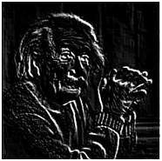
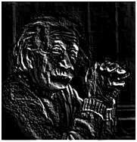
Robinson Compass Masks
Original Image
After applying Mask for North West Direction
After applying Mask for South East Direction

Slide 52
Laplacian Operator
Laplacian Operator is also a derivative operator which is used to find edges in an image. The major difference between Laplacian and other operators like Prewitt, Sobel, Robinson and Kirsch is that these all are first order derivative masks but Laplacian is a second order derivative mask. In this mask we have two further classifications one is Positive Laplacian Operator and other is Negative Laplacian Operator.
Another difference between Laplacian and other operators is that unlike other operators Laplacian didn’t take out edges in any particular direction but it take out edges in following classification.
Inward Edges
Outward Edges

Slide 53
Laplacian Operator
Positive Laplacian Operator:
0 1 0
1 -4 1
0 1 0
Negative Laplacian Operator:
0 -1 0
-1 4 -1
0 -1 0

Slide 54
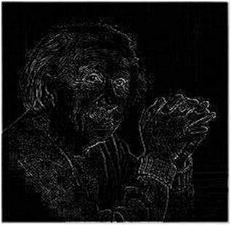
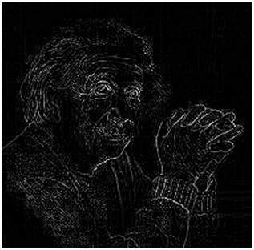
Laplacian Operator
Original Image
After applying Positive Laplacian Operator
After applying Negative Laplacian Operator

Slide 55
Geometric Transformations
We use geometric transformations modify the spatial arrangement of pixels in an image
These transformations are called rubber-sheet transformations because they may be viewed as analogous to “printing” an image on a rubber sheet, then stretching or shrinking the sheet according to a predefined set of rules

Slide 56
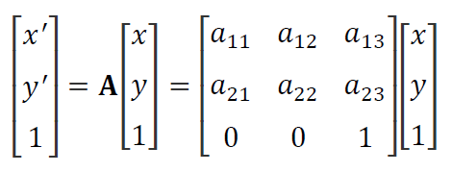
Geometric Transformations
(x, y) are pixel coordinates in the original image
(x’, y’) are the corresponding pixel coordinates of the transformed image
Our interest is in so-called affine transformations, which include scaling, translation, rotation, and shearing
The key characteristic of an affine transformation in 2-D is that it preserves points, straight lines, and planes

Slide 57
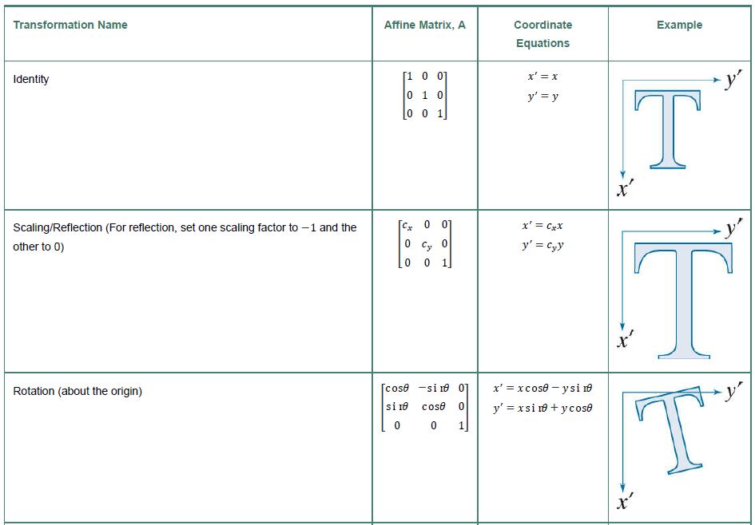
Geometric Transformations
Digital Image Processing, International Edition, Rafael C. Gonzalez & Richard E. Woods

Slide 58
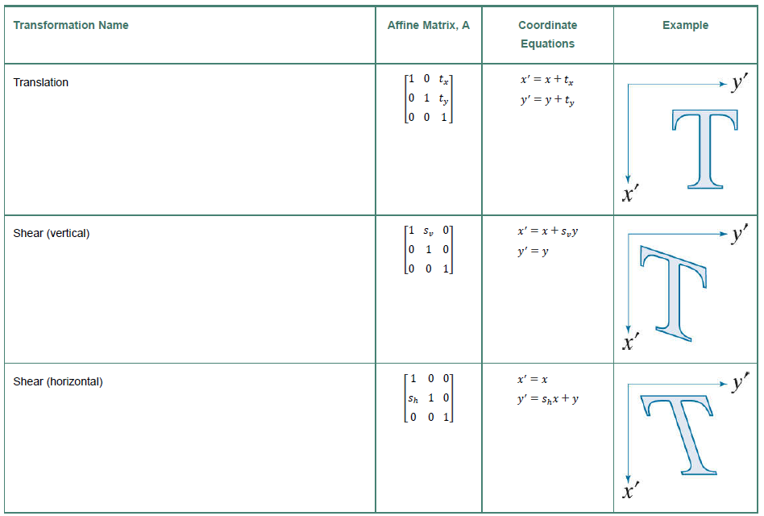
Geometric Transformations
Digital Image Processing, International Edition, Rafael C. Gonzalez & Richard E. Woods

Slide 59
Tutorial
Basic python implementation of some of the algorithms taught in class can be found in the following google colab notebook: https://colab.research.google.com/drive/1JF3ww3l-bBzoC0iy9Ado7eQLcxC1hVFU?usp=sharing

Slide 60
Thank you!

